Slide 1
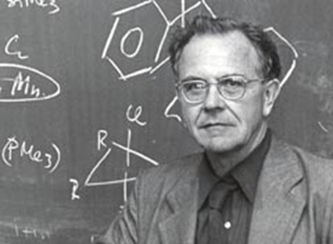
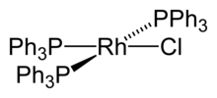
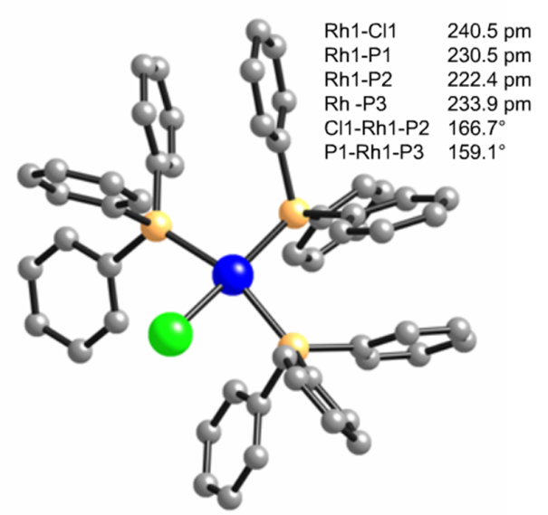
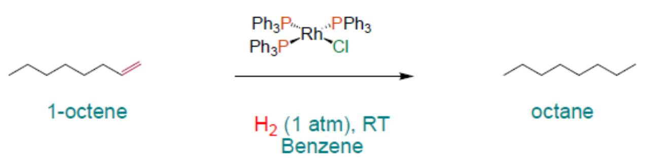
Homogeneous Catalytic Alkene Hydrogenation
RhCl(PPh₃)₃ was the first highly active homogeneous hydrogenation catalyst and was discovered by Geoffrey Wilkinson (Nobel prize winner for Ferrocene) in 1964.
Rates were comparable to heterogeneous catalysts.

Slide 2
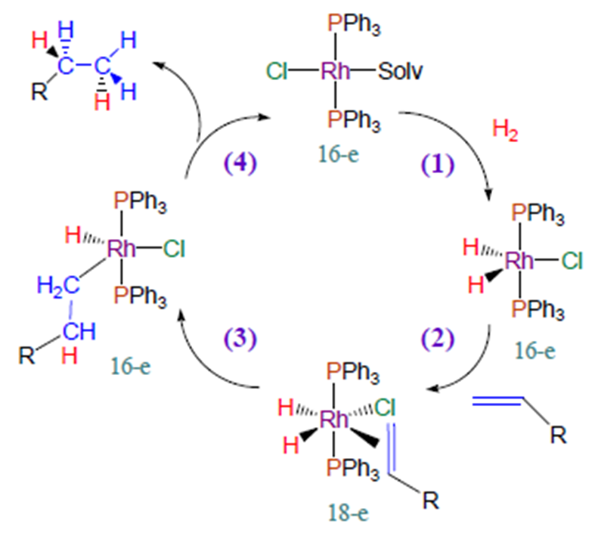
Wilkinson Catalyst: Mechanism of Hydrogenation
In solution, solvent may replace one of the phosphine ligands
Steps:
H₂ addition (oxidative addition)
(2) alkene addition,
(3) migratory insertion
(4) reductive elimination of the alkane, regeneration of the catalyst
Solv

Slide 3
Monsanto Acetic Acid Process
This is the second largest homogeneous catalytic industrial process with over 7 billion pounds of acetic acid produced each year using this technology.
Prior to 1970, acetic acid was made using cobalt catalysts (BASF process) requiring rather severe conditions. In 1970 Monsanto commercialized a rhodium carbonyl iodide catalyst that is commonly called the Monsanto Acetic Acid Process (developed in the late 60's by James Roth at the corporate research center in St. Louis).
In 1986 Monsanto sold the acetic acid plant and technology to British Petroleum, but it is still commonly referred to as the Monsanto Acetic Acid process.
 | Cobalt | Rhodium
Concentration | ~ 10⁻¹ M | ~ 10⁻³ M
Temperature | ~ 230°C | ~180°C
Pressure | 500-700 atm | 30-40 atm
Selectivity | 90% | > 99%
H₂ effect | CH₄, CH₃CHO, EtOH byproducts | no adverse effect

Slide 4
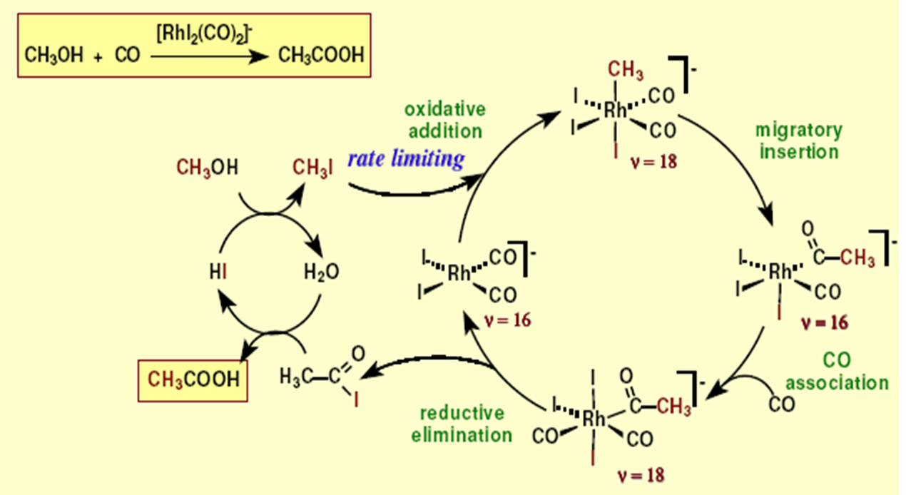
Mechanism

Slide 5
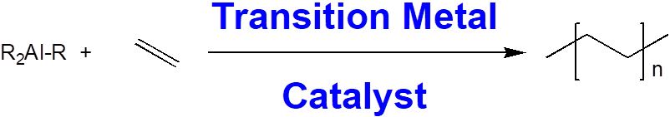
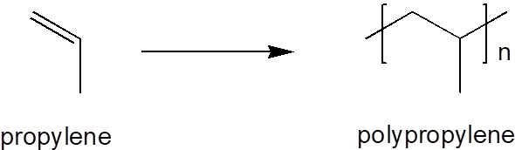
Ziegler-Natta Polymerization
Karl Ziegler: German chemist, Nobel prize 1963
1953/54: oligomerization of ethylene by trialkylaluminum compounds (high pressure and temperature). (A case of heterogeneous catalysis).
In the presence of trace transition metals, it was found that the reaction took place at a much lower temperature and pressure.
Polymer had a linear, unbranched structure with high molecular weight
TiCl₃ was frequently employed
as catalyst
Giulio Natta: Italian chemist, Nobel prize 1963
Learned of Ziegler’s research, and applied findings to other olefins such as propylene and styrene.
Resulting polypropylene was made up of two fractions: amorphous (atactic) and crystalline (tactic). Polypropylene is not produced in radical initiated reactions.

Slide 6
Natta’s Discovery: Selectivity in Tacticity
Isotactic and syndiotactic polymers are crystalline, atactic is amorphous.
Different catalysts allow control of tacticity.
Isotactic
Syndiotactic

Slide 7
Homogeneous Metallocene Catalysts

Slide 8
Transition Metals in Biology
Transport and storage proteins : Transferrin (Fe) , Ferritin (Fe), Metallothionein (Zn)
O₂ binding/transport: Myoglobin (Fe), Hemoglobin (Fe),Hemerythrin (Fe)
Hemocyanin (Cu)
Enzymes (catalysts)
Hydrolases: Carbonic anhydrase (Zn), Carboxypeptidase (Zn)
Oxido-Reductases: Alcohol dehydrogenase (Zn), Superoxide dismutase (Cu, Zn,Mn, Ni), Catalase, Peroxidase (Fe), Nitrogenase (Fe, Mo), Cytochrome oxidase (Fe, Cu), Hydrogenase (Fe, Ni)
Isomerases: B₁₂ coenzymes (Co), Aconitase (Fe-S)
Oxygenases: Cytochrome P450 (Fe), Nitric Oxide Synthases (Fe)
Electron carriers: Cytochromes (Fe)
Electron transferases Iron-sulfur (Fe)
Blue copper proteins (Cu)
Non Proteins
Transport Agents: Siderophores (Fe)

Slide 9
Oxygen Storage and Transport
Oxygen
required for oxidative metabolism and energy production in most cells
O₂ the terminal electron acceptor in aerobic metabolism used to oxidize dietary substrates to carbon dioxide, yielding energy
Hemoglobin (Hb) used by vertebrates
to transport O₂ to tissues from lungs
to transport CO₂ from tissues to lungs
Myoglobin (Mb) used in some tissues, notably muscle,
as a storage reserve of O₂ and
for intracellular transport of O₂

Slide 10
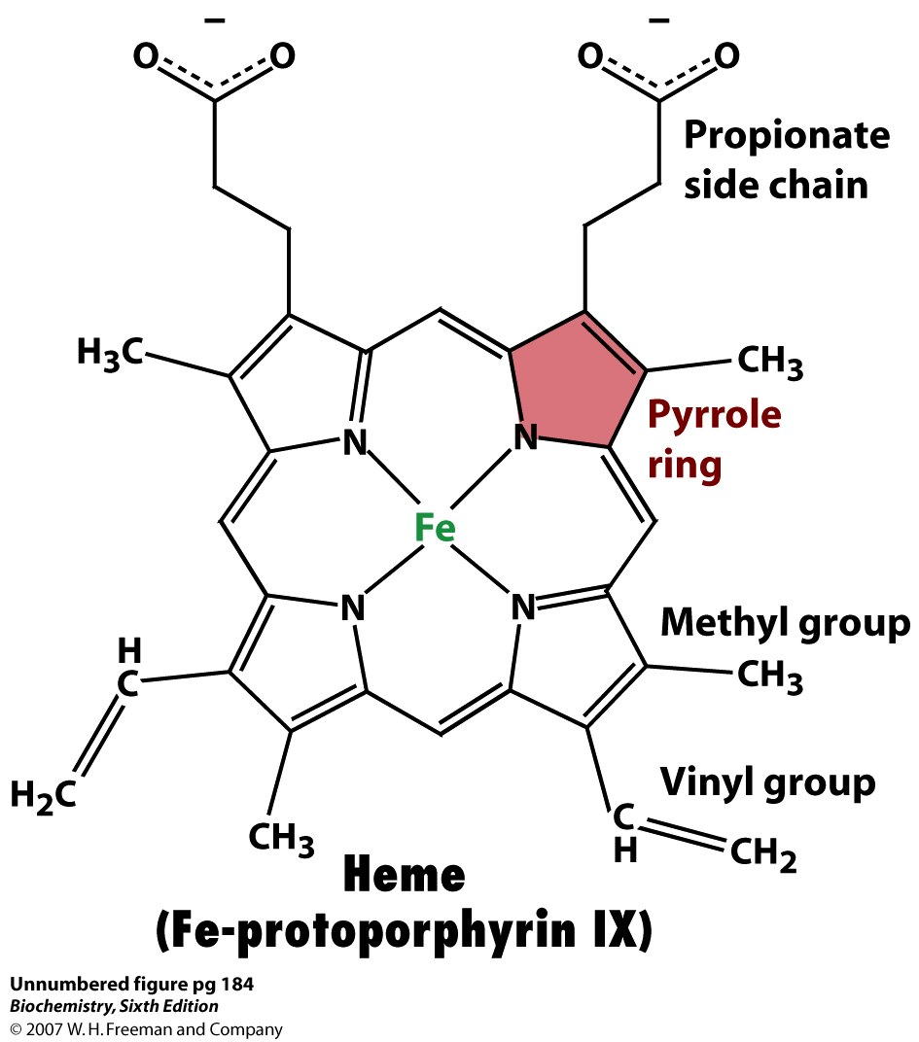
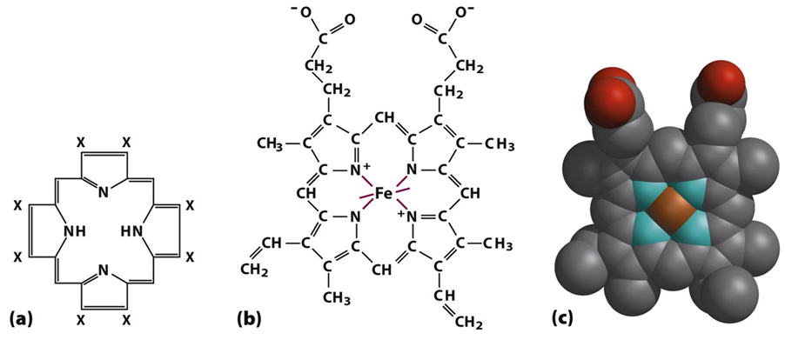
Heme Prosthetic Group in Mb and Hb
Mb and Hb both bind O₂ with the help of a heme prosthetic group
prosthetic group: a metal ion or an organic or metalloorganic compound other than an amino acid that's tightly bound to a protein (sometimes covalently, sometimes TIGHT but noncovalent binding) and is required for the protein's function/activity
Heme (Fe²⁺) has affinity for O₂.
Located in crevice where it is protected from oxidation.

Slide 11
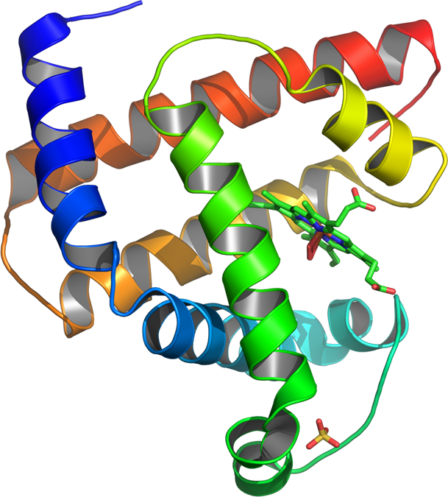
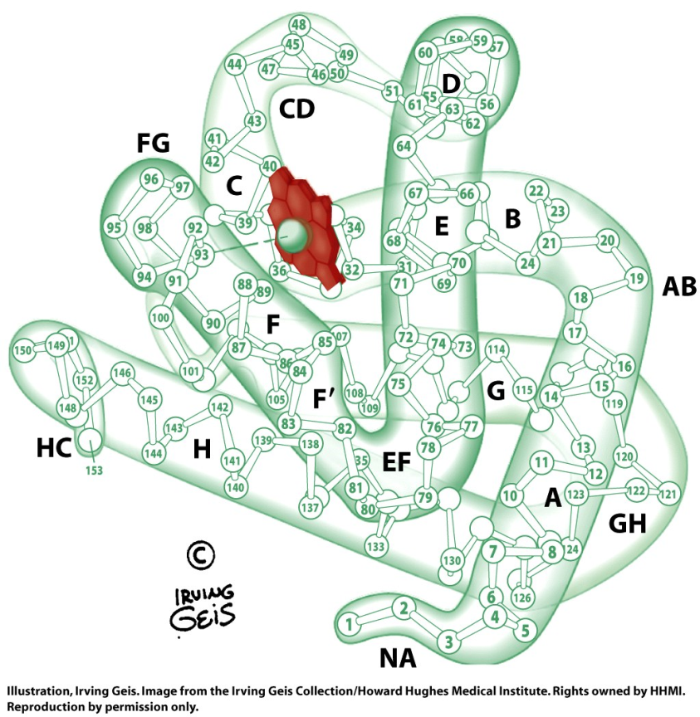
Structure of Myoglobin (Mb)
Single polypeptide with 154 amino acids (human version)
8 α helices (A-H)
Located in skeletal & cardiac muscle
function of Mb is to bind O₂ that has been delivered to tissues by the hemoglobin in the blood
1) storing the O₂ until it's needed as terminal electron acceptor for energy metabolism, and
2) transporting it within the cell

Slide 12
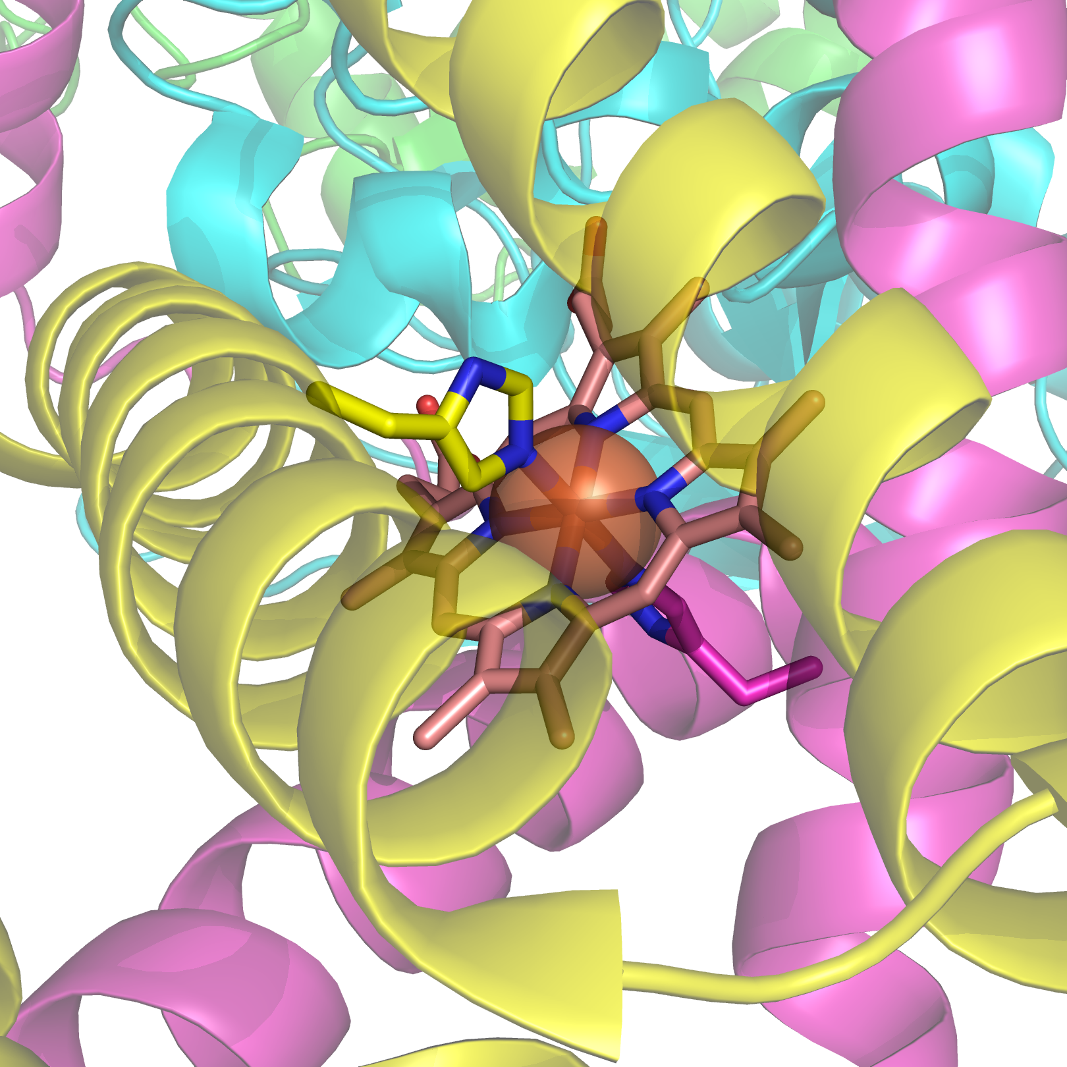

Slide 13
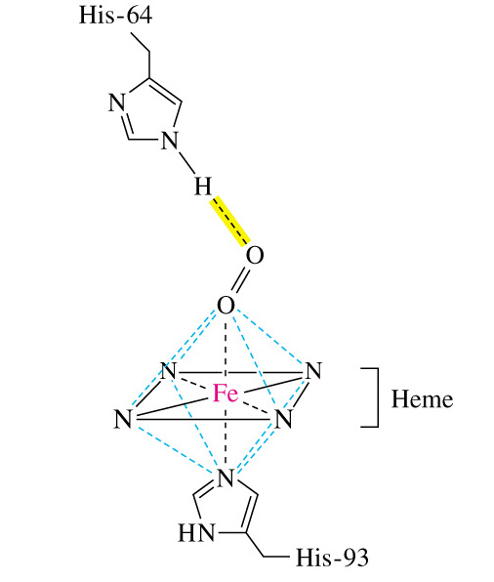
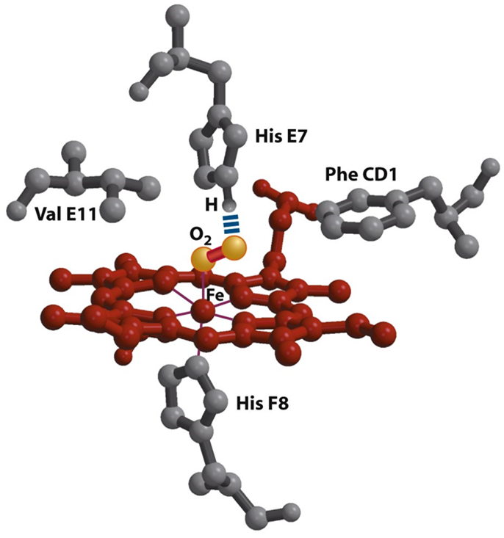
Oxygen Binding to Myoglobin
O₂ binds to only available coordination site on iron atom.
His 93 (proximal his) binds directly to iron.
His 64 (distal his) stabilizes the O₂ binding site.
distal histidine
proximal histidine

Slide 14
Oxygen Binding Curve for Myoglobin
Myoglobin has high affinity for O₂.
P₅₀ = 2.8 Torr
Allows myoglobin to act as O₂ storage reserve.
Releases O₂ when pO₂ becomes low indicating O₂ deprivation.
100
saturation with O₂
50
tissues
arterial pressure
2.8
20
100
pO₂ (partial pressure of O₂) (Torr)

Slide 15
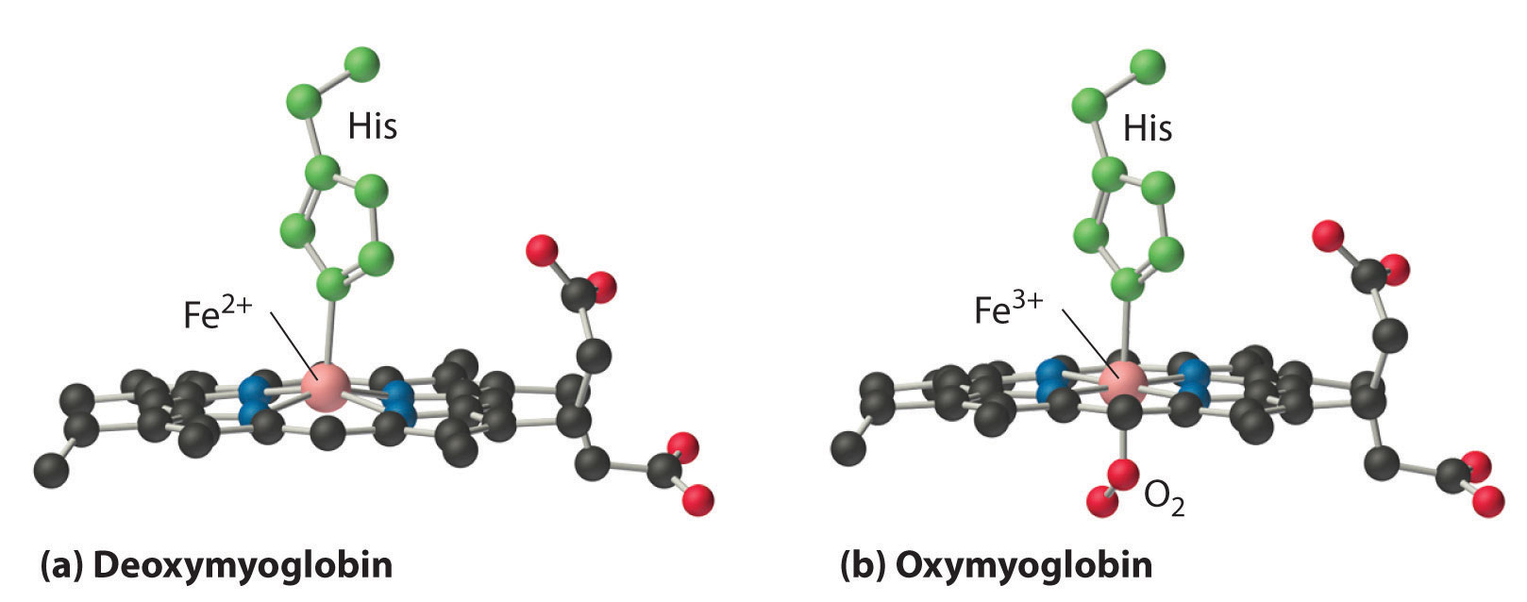
Structural Changes in Myoglobin Upon O₂ Binding
Oxygen binding changes the Mb conformation
Without oxygen bound, Fe is out of heme plane
Oxygen binding pulls the Fe into the heme plane
O₂ binds to only available coordination site on iron atom.
Fe pulls its His F8 ligand along with it
This change means little to Mb, but lots to Hb!

Slide 16
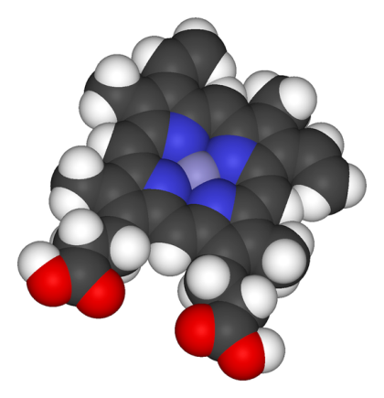
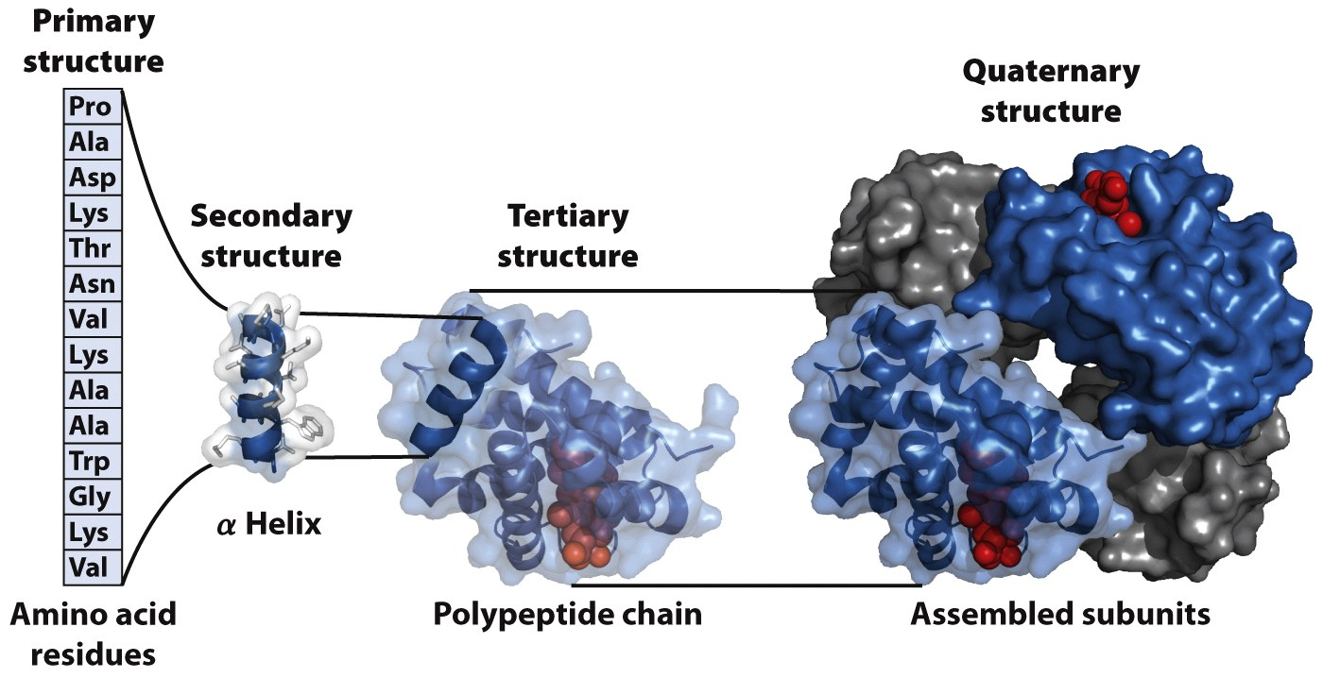
Hemoglobin: Oxygen Transport

Slide 17
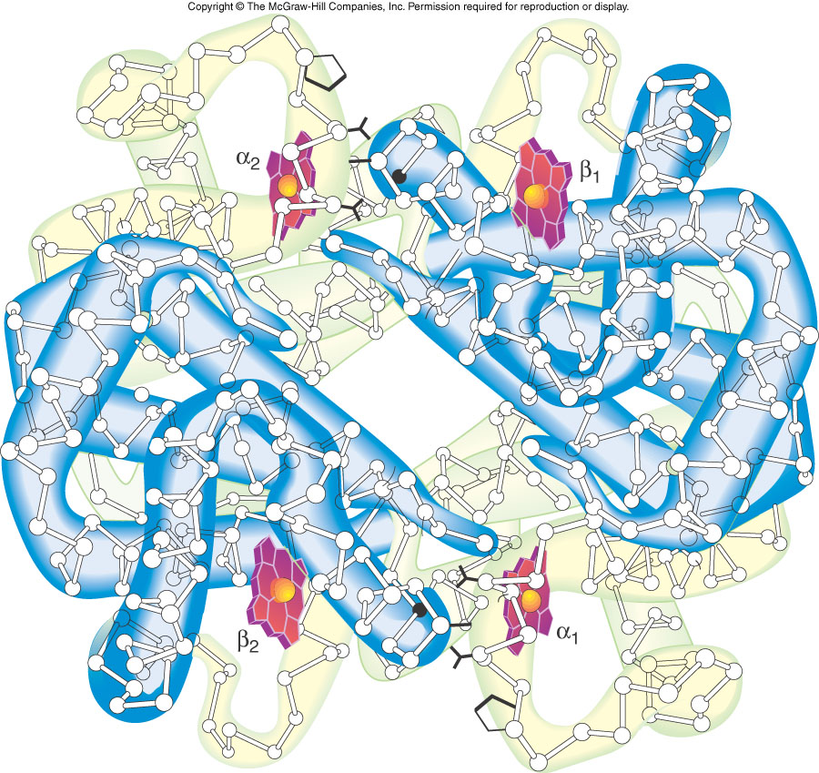
Hemoglobin: Quaternary Structure
α₂β₂
Two α (141 AA/ α)subunits and two β (146 AA/ β)subunits

Slide 18
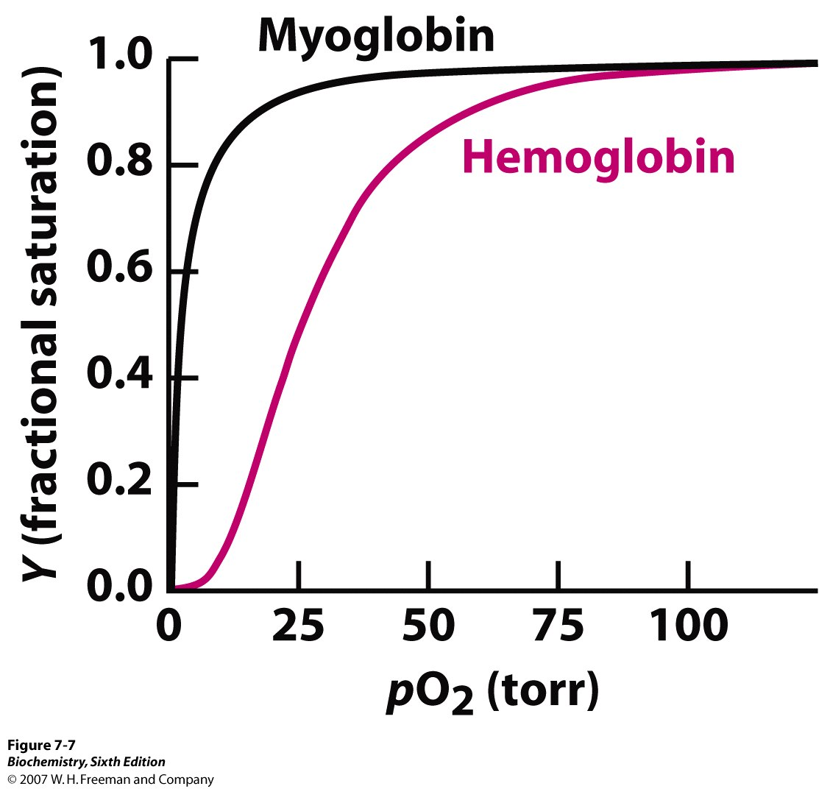
Oxygen Binding Curve for Hemoglobin
Unlike Mb, Hb displays a sigmoidal binding curve.
Among other things, the curve indicates that the affinity of Hb for oxygen is lower than that of Mb!

Slide 19
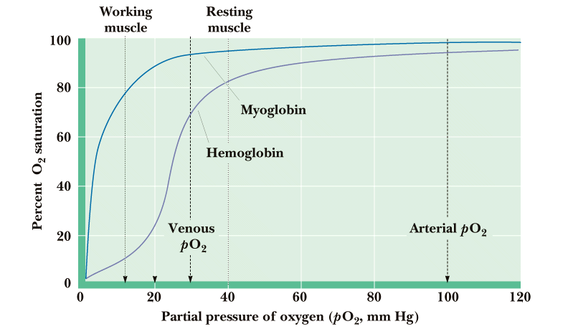
Physiological Significance Of O₂ Binding to Hb
Hb must be able to bind oxygen in the lungs
Hb must be able to release oxygen in capillaries
If Hb behaved like Mb, very little oxygen would be released in capillaries
The sigmoid, cooperative oxygen binding curve of Hb makes this possible!

Slide 20
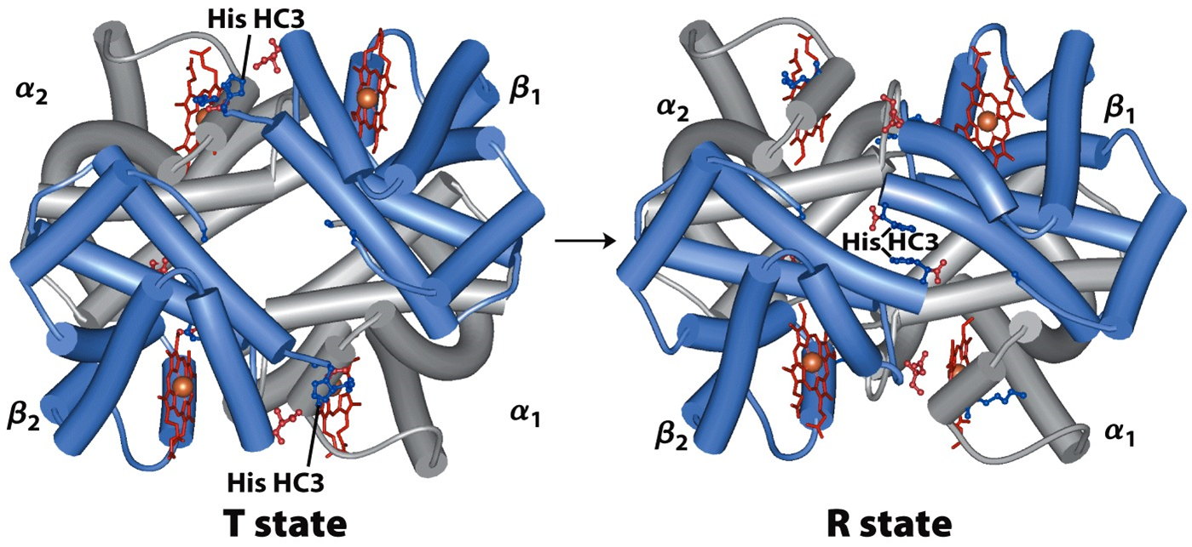
Hemoglobin is an α2β2 tetramer that changes conformation from a T state to R state upon binding oxygen
Hemoglobin: T and R states

Slide 21
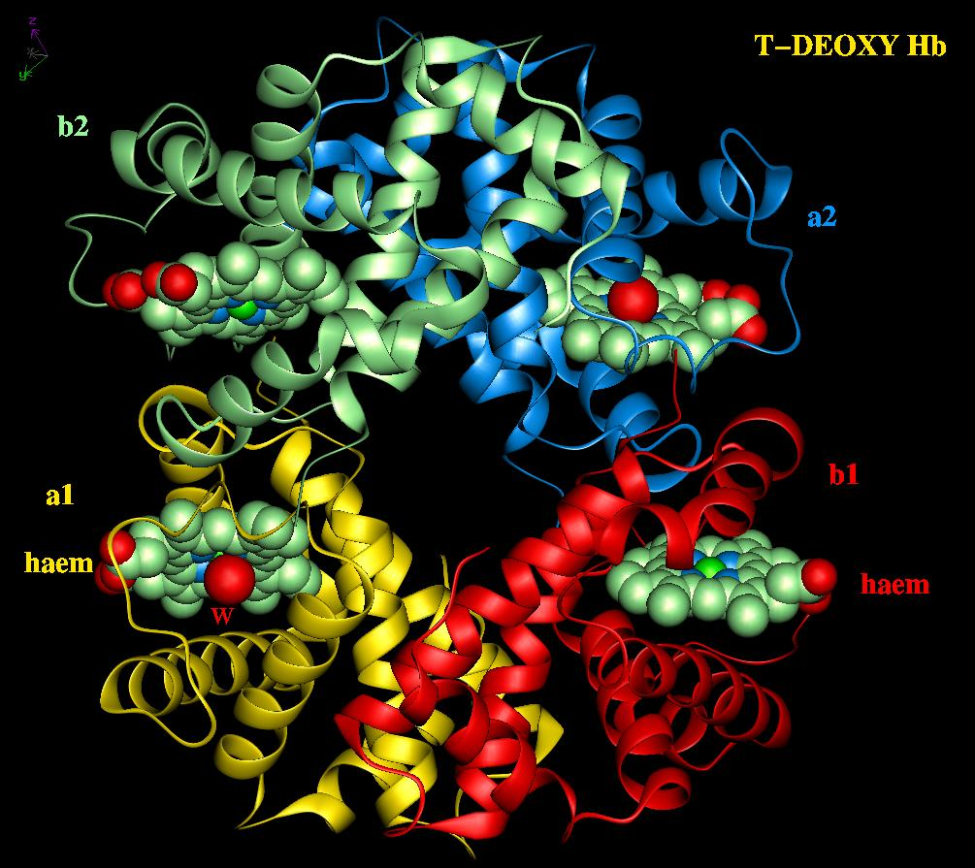
O₂ Binding to Hemoglobin
Water bound to heme Iron

Slide 22
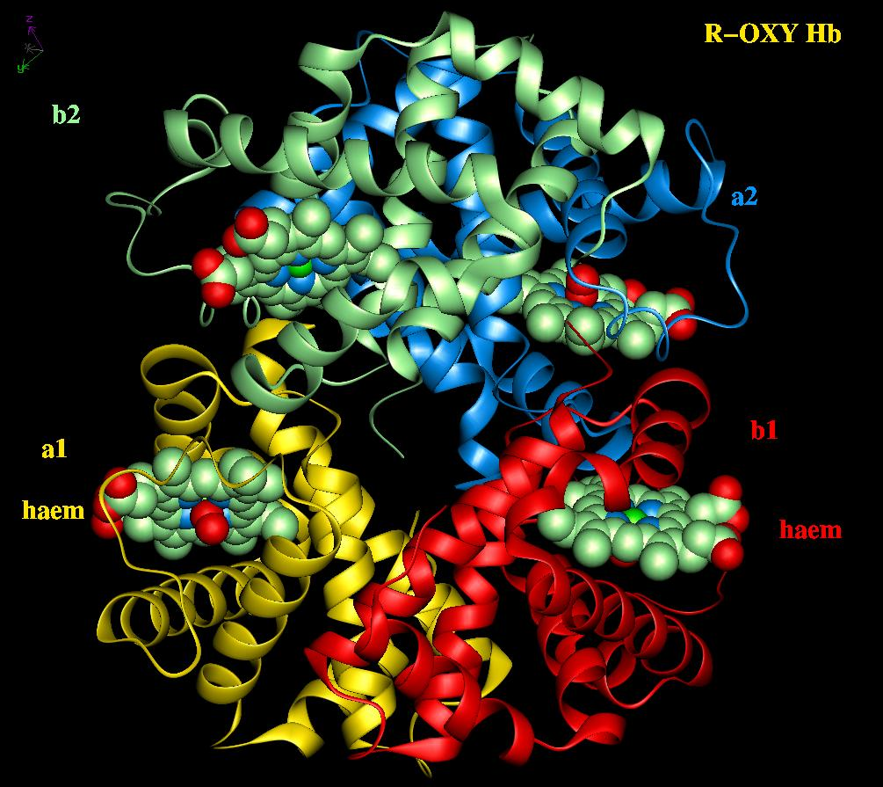
O₂ Binding to Hemoglobin
Oxygen bound to heme Iron

Slide 23
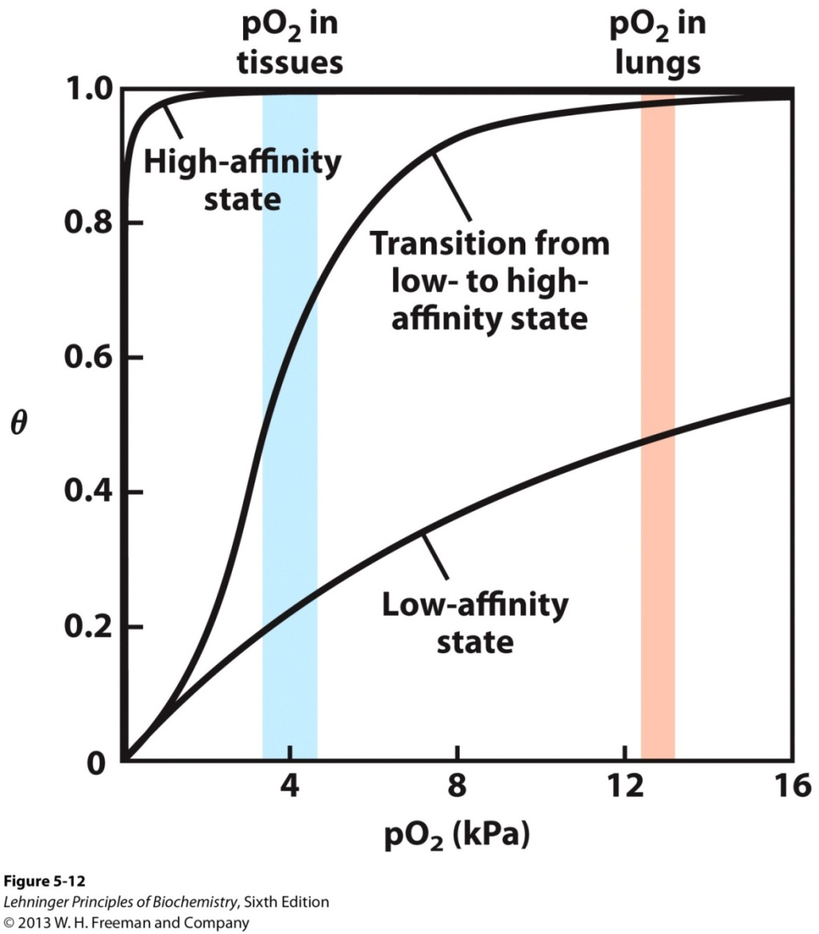
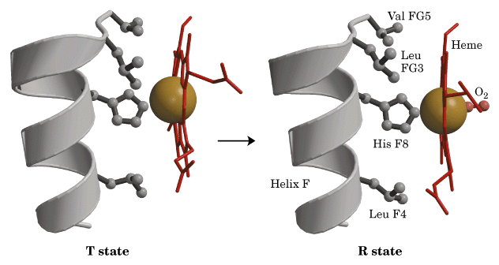
Significance of Sigmoidal Curve
The sigmoidal shape of the curve in indicates cooperative binding of oxygen (meaning that progressive binding of oxygen increases the affinity of Hb to oxygen!)
This increase in affinity means that there is a shift from the T to the R state.

Slide 24
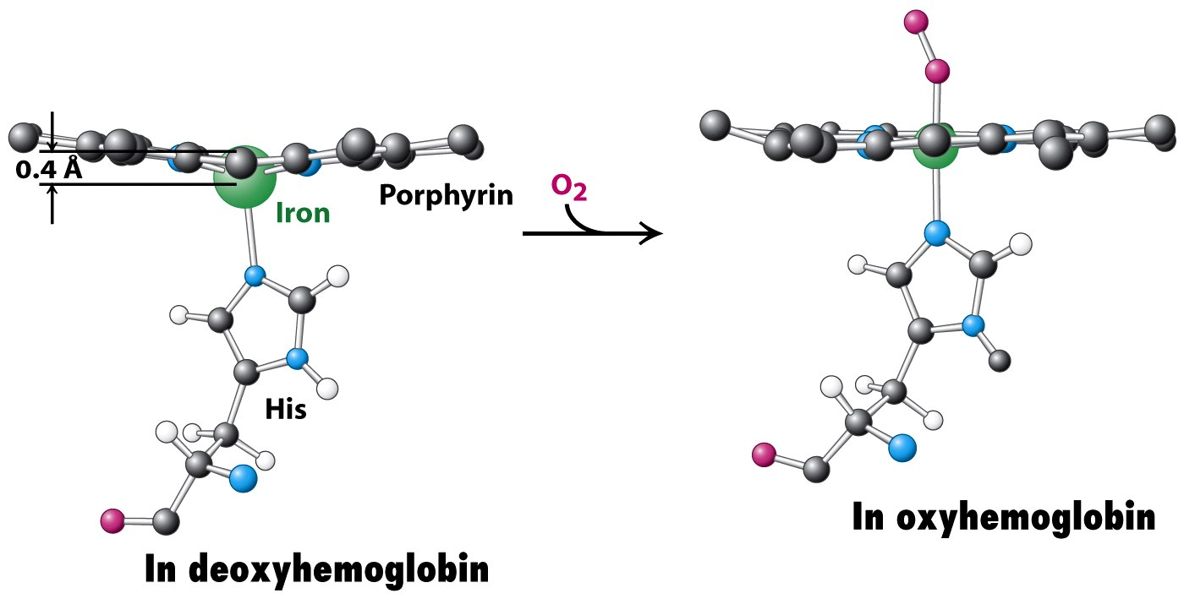
Structural Changes in Hemoglobin Upon O₂ Binding

Slide 25
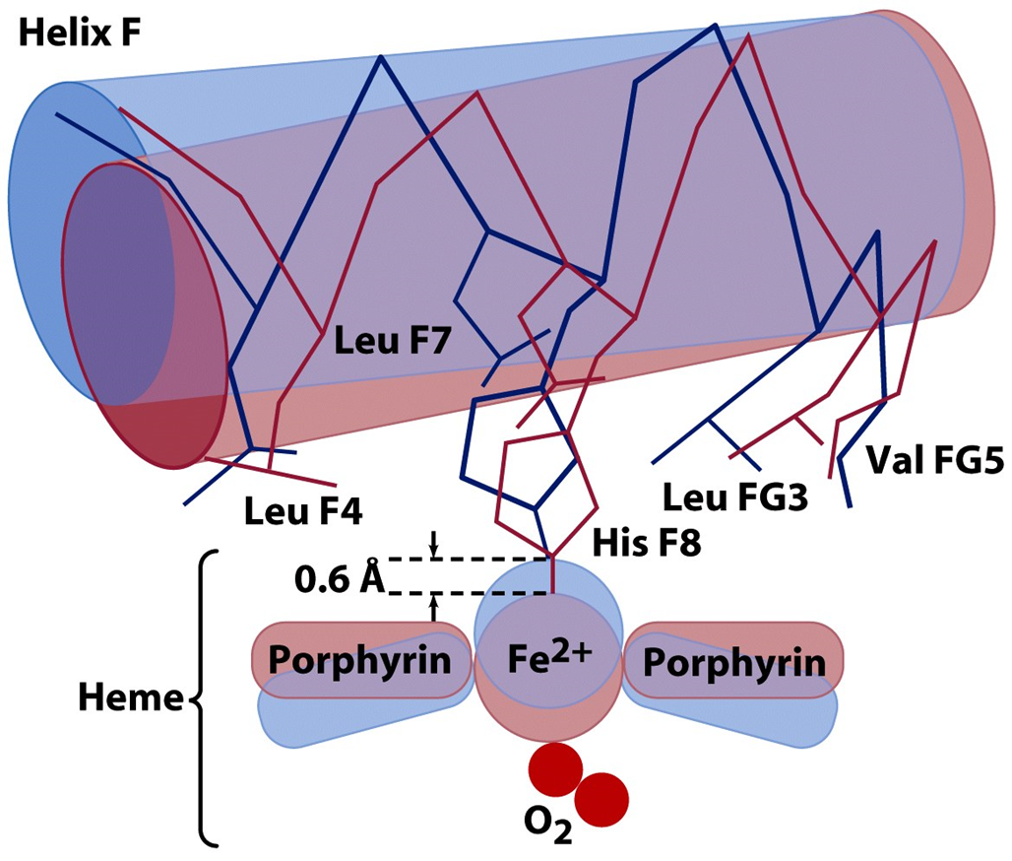
Hemoglobin Conformational Change
But how can a hemoglobin molecule “know” that one of its subunits has bound an oxygen already?

Slide 26
Hemoglobin Conformational Change
But how can a hemoglobin molecule “know” that one of its subunits has bound an oxygen already?
When an oxygen binds to the heme, the heme ring “bends” such that it is planar; this in turn pulls His F8 down.

Slide 27
Hemoglobin Conformational Change
But how can a hemoglobin molecule “know” that one of its subunits has bound an oxygen already?
When an oxygen binds to the heme, the heme ring “bends” such that it is planar; this in turn pulls His F8 down 0.6 Å
Which then moves helix F 1 Å

Slide 28
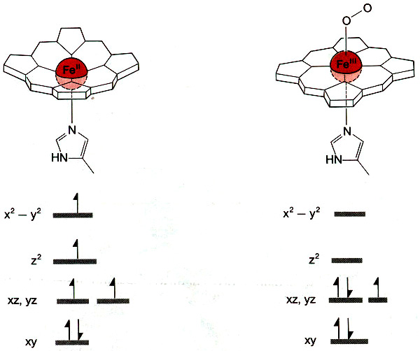
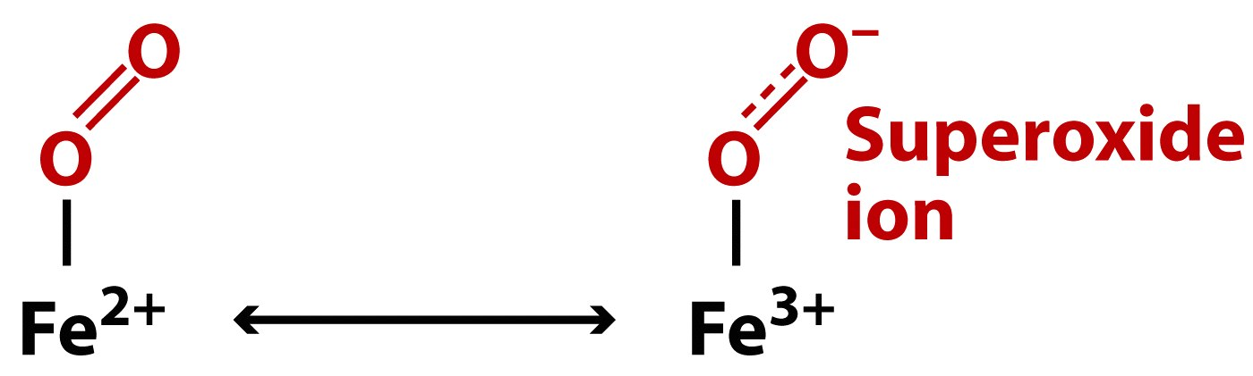
Coordination Environment of Fe
Unpaired electron on Fe(III) is weakly coupled to unpaired electron on O₂⁻
High-spin
Ferrous;
paramagnetic
Low-spin
Ferric;
diamagnetic

Slide 29
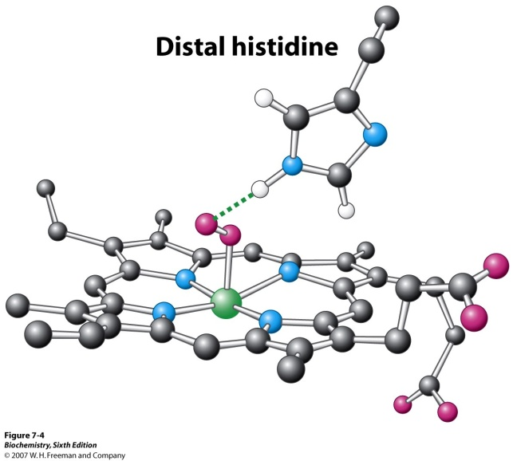

Maintaining the Heme Functionality
Ferrous Oxymyoglobin [Fe²⁺/O₂]
Ferrous Deoxymyoglobin [Fe²⁺] + O₂
toxicity
Ferric Oxymyoglobin [Fe³⁺/O₂⁻]
X
Metmyoglobin [Fe³⁺] + O₂^{-.}
(unable to bind O₂)
Oxygen must leave as dioxygen rather than superoxide. Why?
Reversible oxygen binding and storage
The hydrogen bonding between the distal histidine and oxygen stabilizes the ferric (Fe³⁺) form of oxymyoglobin and does not allow superoxide release.
Oxygen can be released only from the ferrous (Fe²⁺) form of oxymyoglobin.

Slide 30
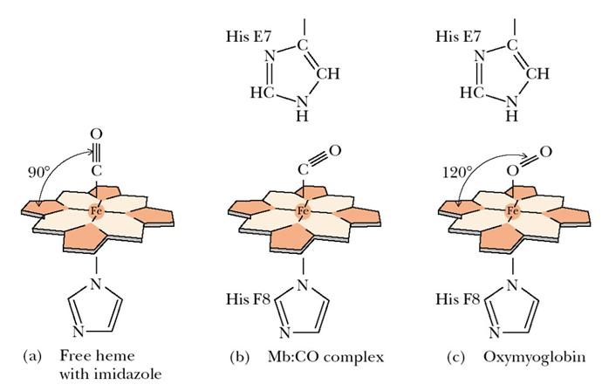
CO binding to Mb and Hb
Carbon monoxide is produced continuously in the body by degradation of the porphyrin ligand (even in nonsmokers).
Under normal conditions, CO occupies approximately 1% of the heme sites in hemoglobin and myoglobin.
Although CO has a much greater affinity for a ferrous heme than does O₂ (by a factor of about 25,000), the affinity of CO for deoxyhemoglobin is only about 200 times greater than that of O₂, which suggests that something in the protein is decreasing its affinity for CO by a factor of about 100
Both CO and NO bind to ferrous hemes in a linear fashion.
In Mb and Hb, distal His forces bent binding of both, weakens CO binding.

Slide 31
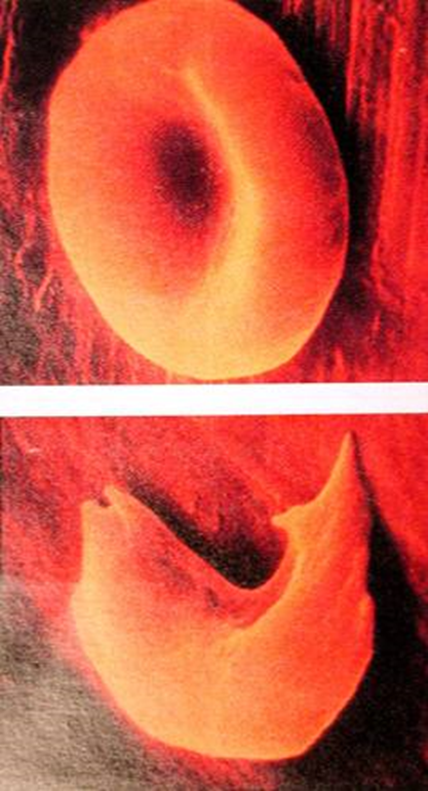
Sickle Cell Anemia
Genetically transmitted disease
HbS: Sickle cell Hb; HbA: Normal Hb
Normal red blood cells are round like doughnuts, and they move through small blood tubes in the body to deliver oxygen.
There are large number of genetic variations in the Hb subunits, all of which affect oxygen binding.
Sickle red blood cells (HbS) become hard, sticky and shaped like sickles. When these hard and pointed red cells go through the small blood tube, they clog the flow and break apart. This can cause anemia.
Sickle-cell variant of hemoglobin – a one-residue change in the primary sequence of each β chain: Val (6) Glu – enough to change the shape of the erythrocyte into a linear structure, not a disk.

Slide 32
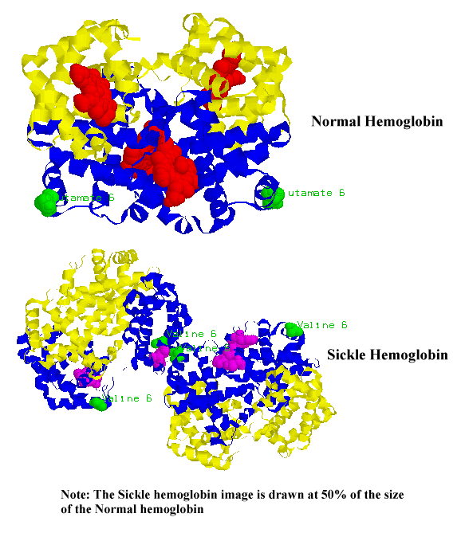
Mutation Leading to HbS

Slide 33
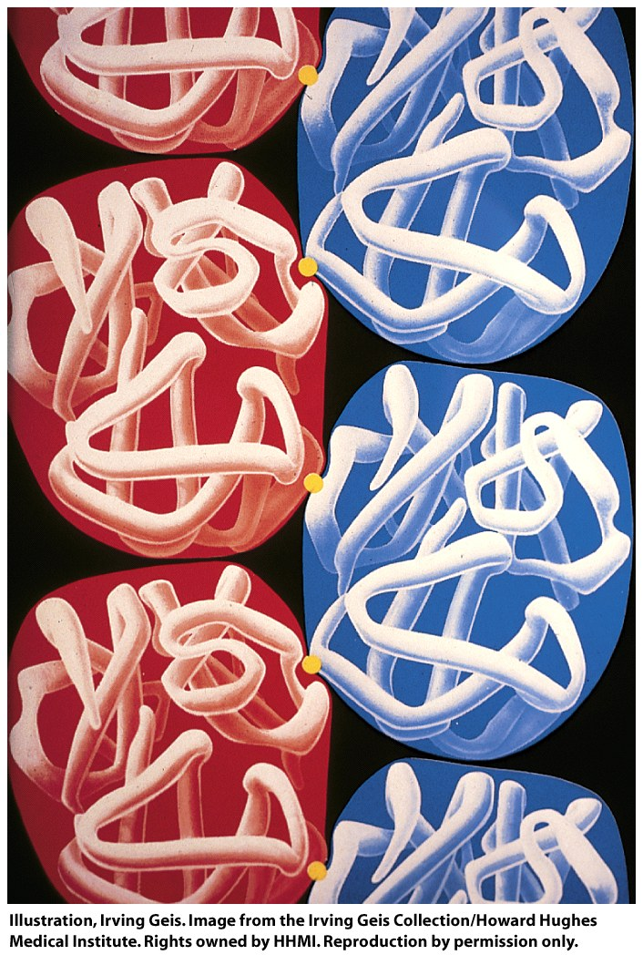
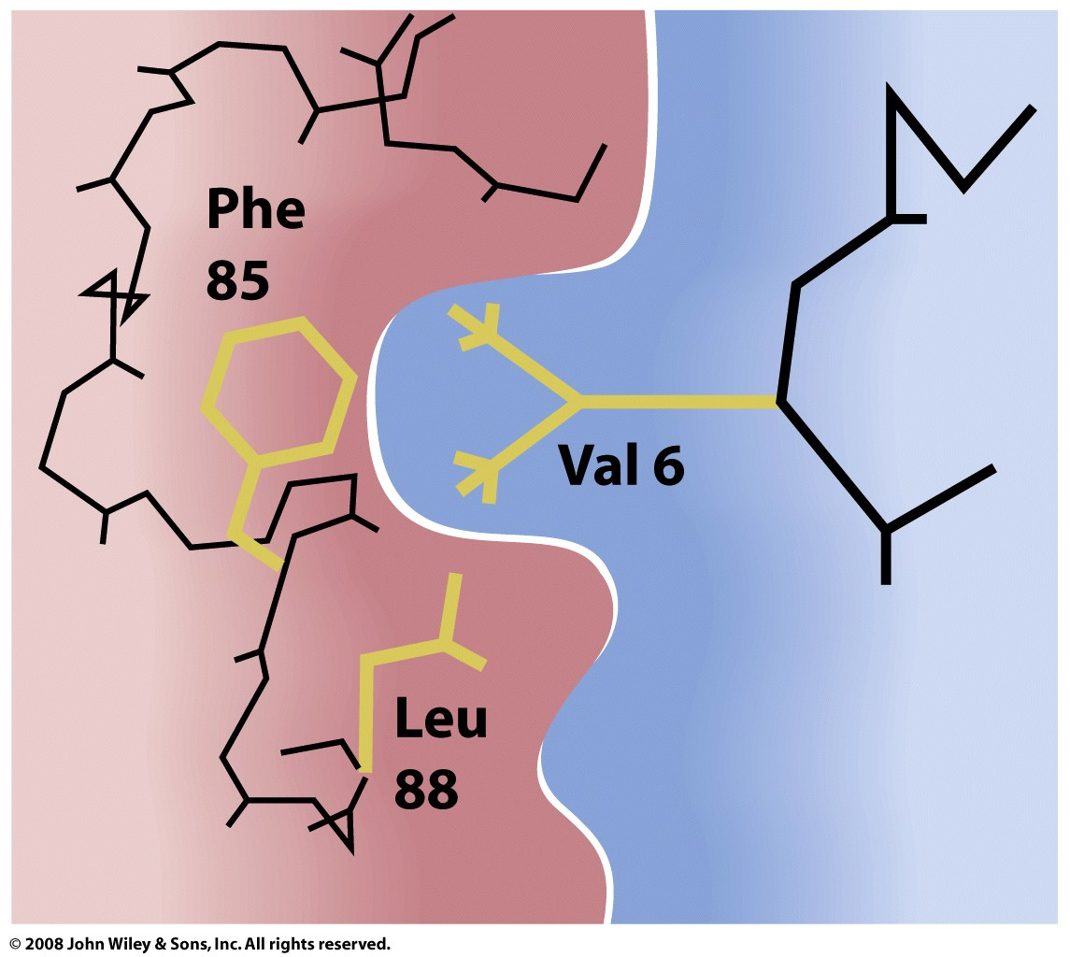
The mutant valine residue can now interact with two nonpolar residues on a different chain of a different molecule – something glutamic acid could not do.

Slide 34
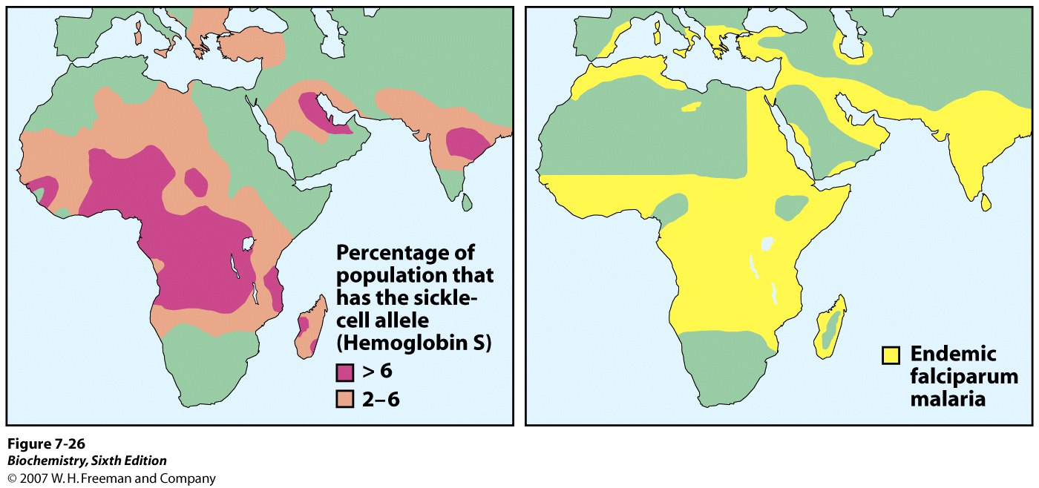
HbS as Evolutionary Response to Malaria
The protozoan that causes malaria must live in erythrocytes for some of its life; without exclusively normal-shaped blood cells, the sickle-cell carrier suffers less from malaria.

